Slide 1
Creative Coding
Final Project Ideas

Slide 2
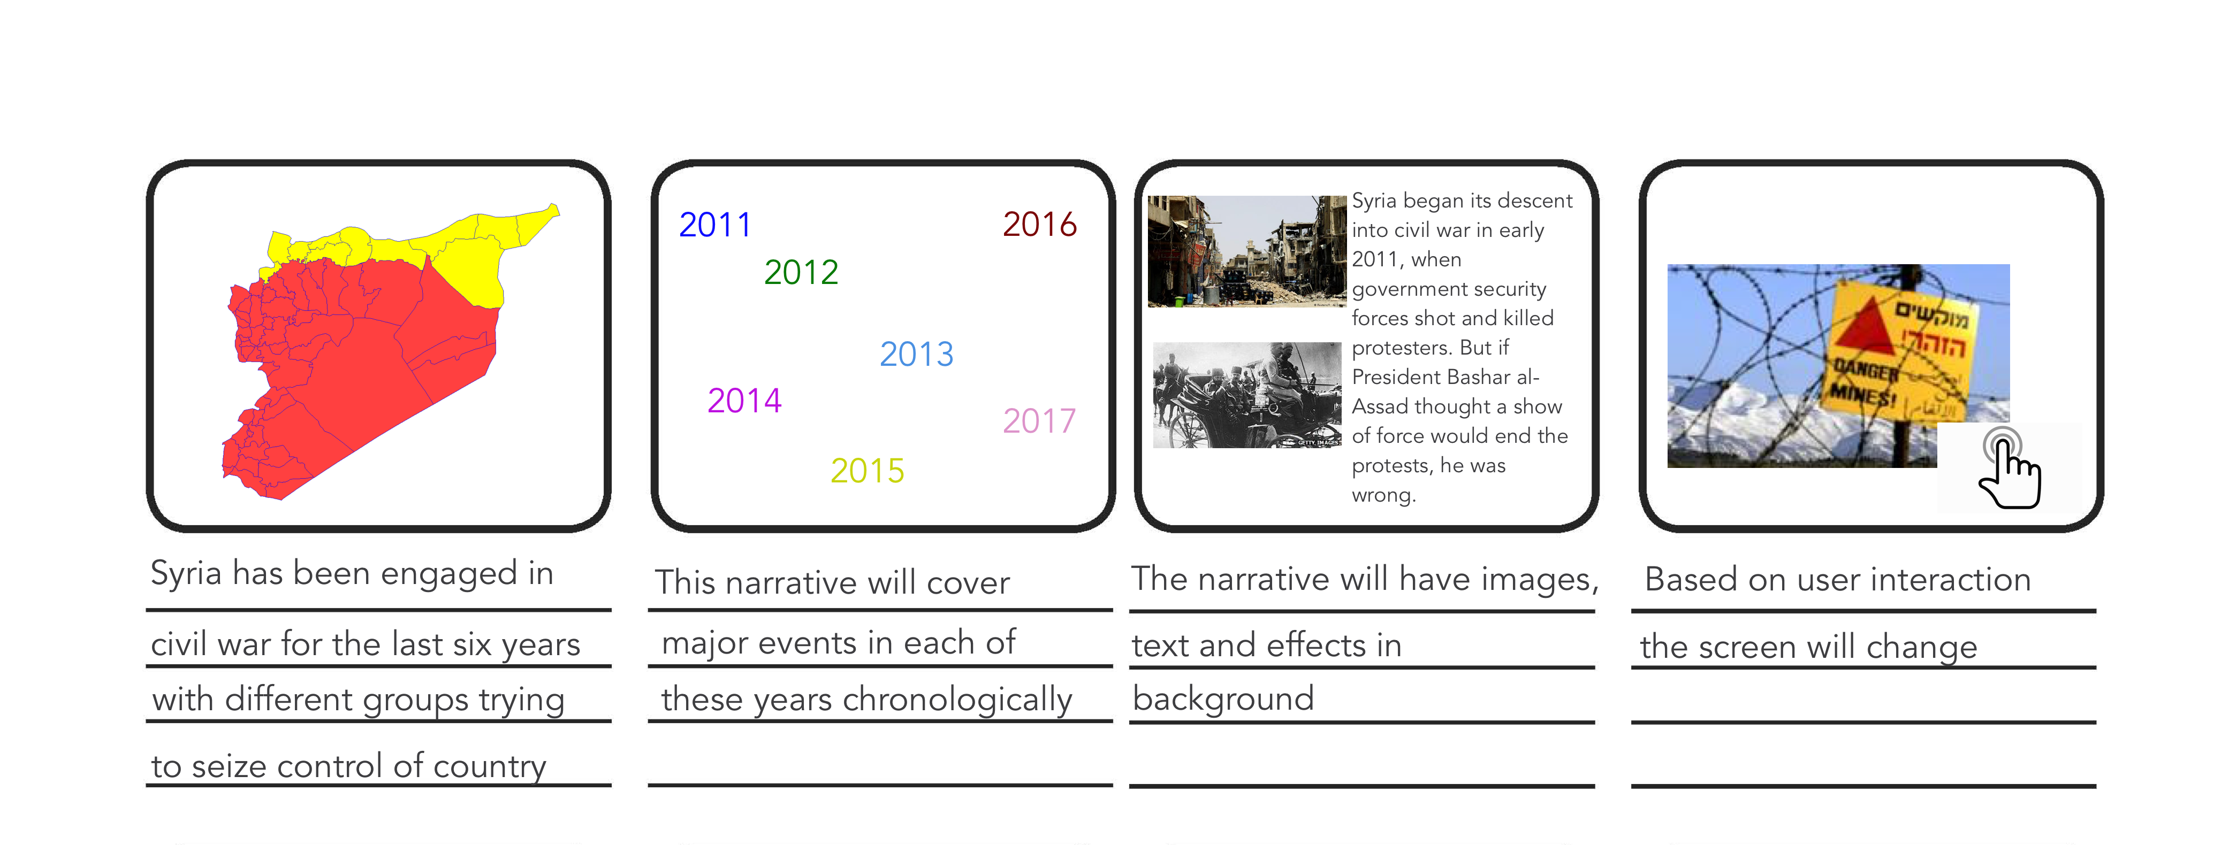
Awareness Narrative on Syria Situation
Notes:
http://www.bbc.com/news/world-middle-east-14703995

Slide 3
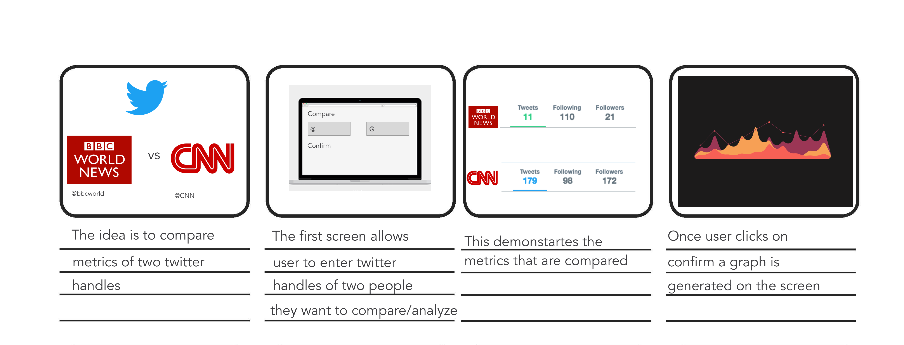
Twitter Analytics
Notes:
http://blog.blprnt.com/blog/blprnt/quick-tutorial-twitter-processing

Slide 4
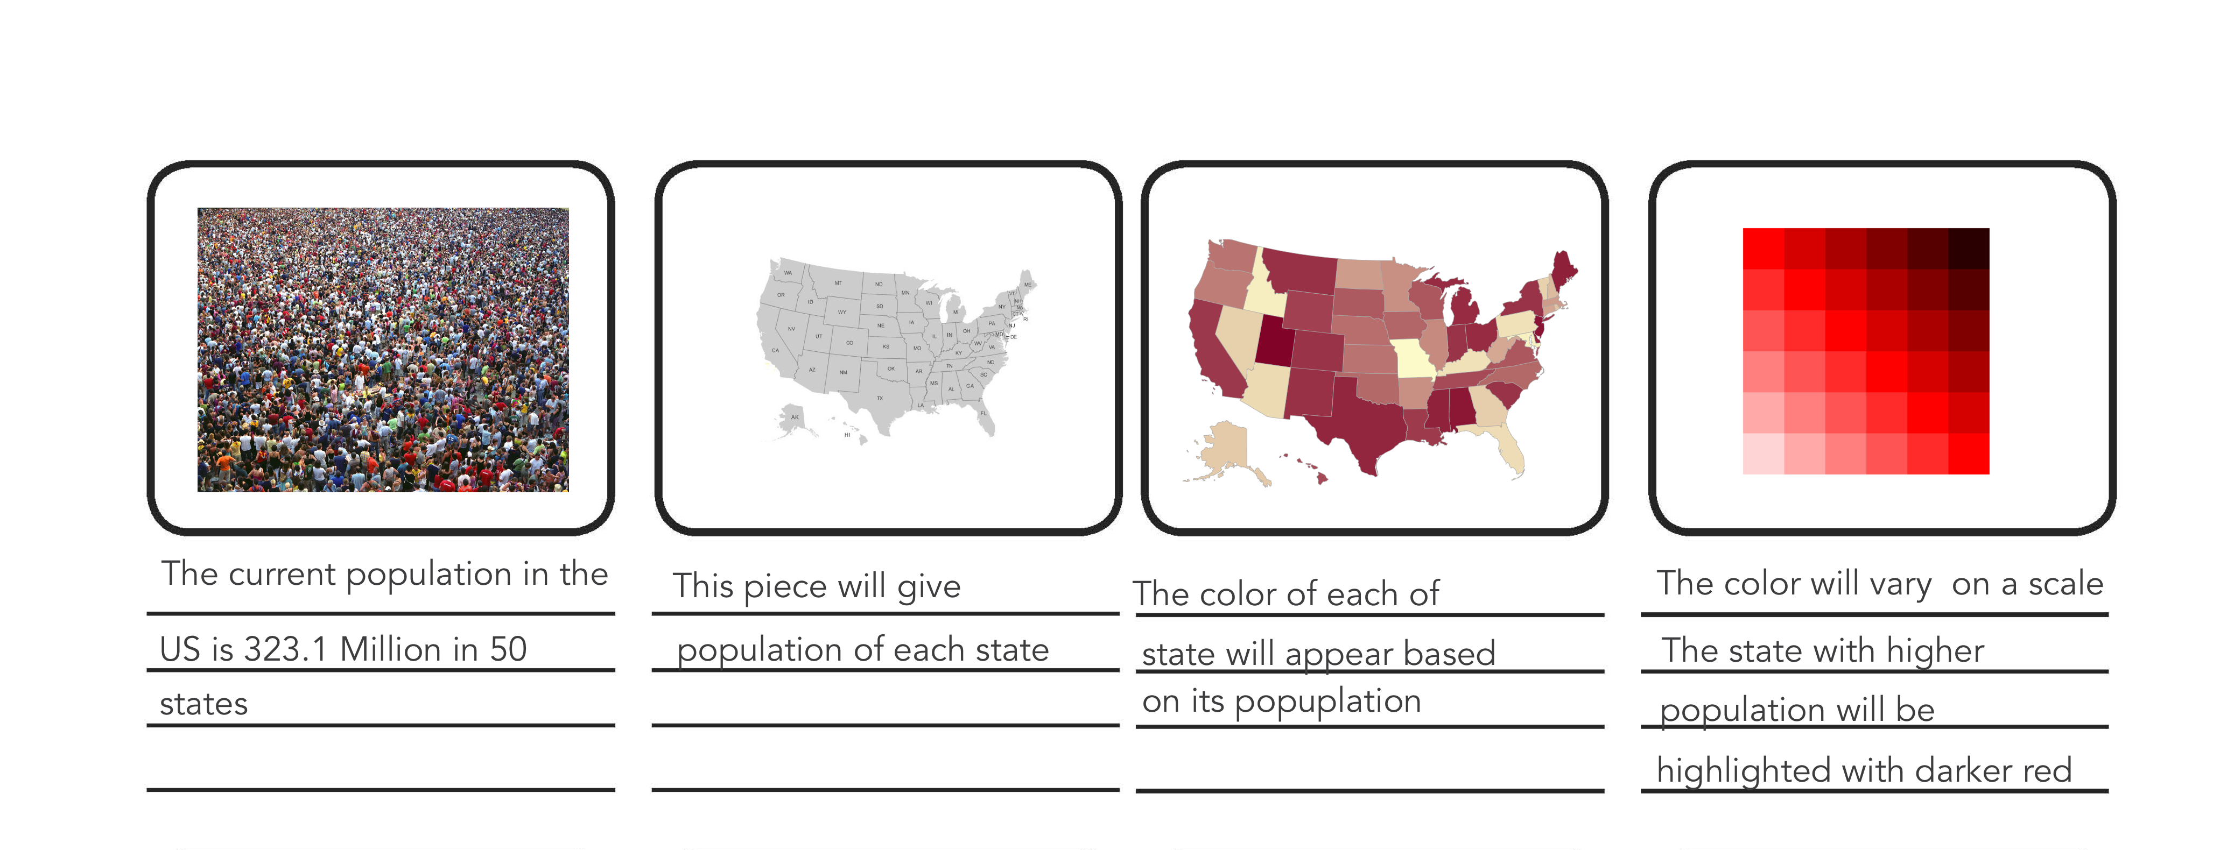
Data Visualization of Population in United States
Notes:
http://theundocumented.com/
https://bl.ocks.org/mbostock/4062085
https://www.census.gov/dataviz/visualizations/043/
http://roberthodgin.com/portfolio/work/murmuration/

Slide 5
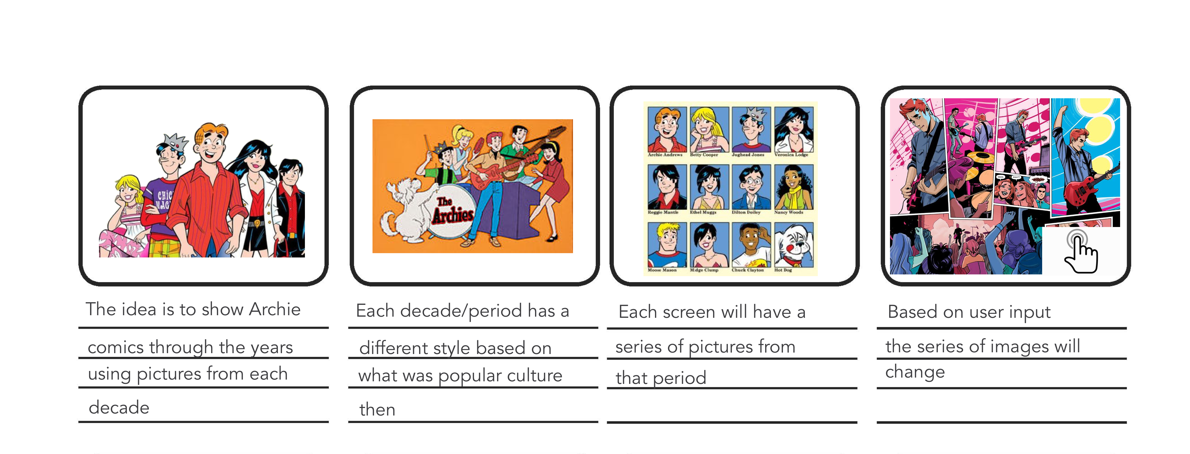
Archie through the years
Notes:
http://www.sbs.com.au/theboat/
http://moebio.com/

